Slide 1
Senior Data Scientist Salary Recommendation
We are hiring a Senior Data Scientist to support company-wide AI and data efforts.
To remain competitive, we analyzed global salary data for:
Experience Level
U.S. vs Global roles
Remote work trends

Slide 2
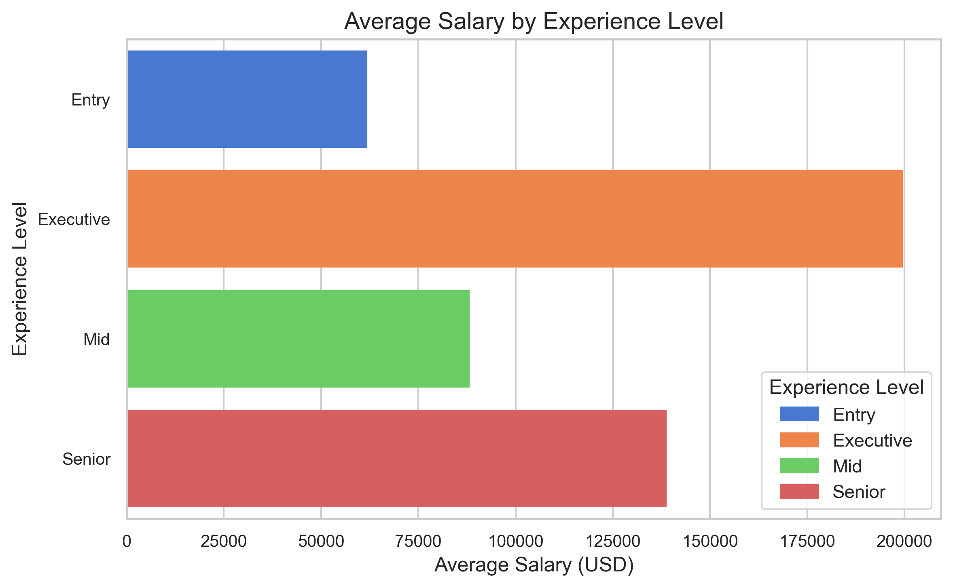
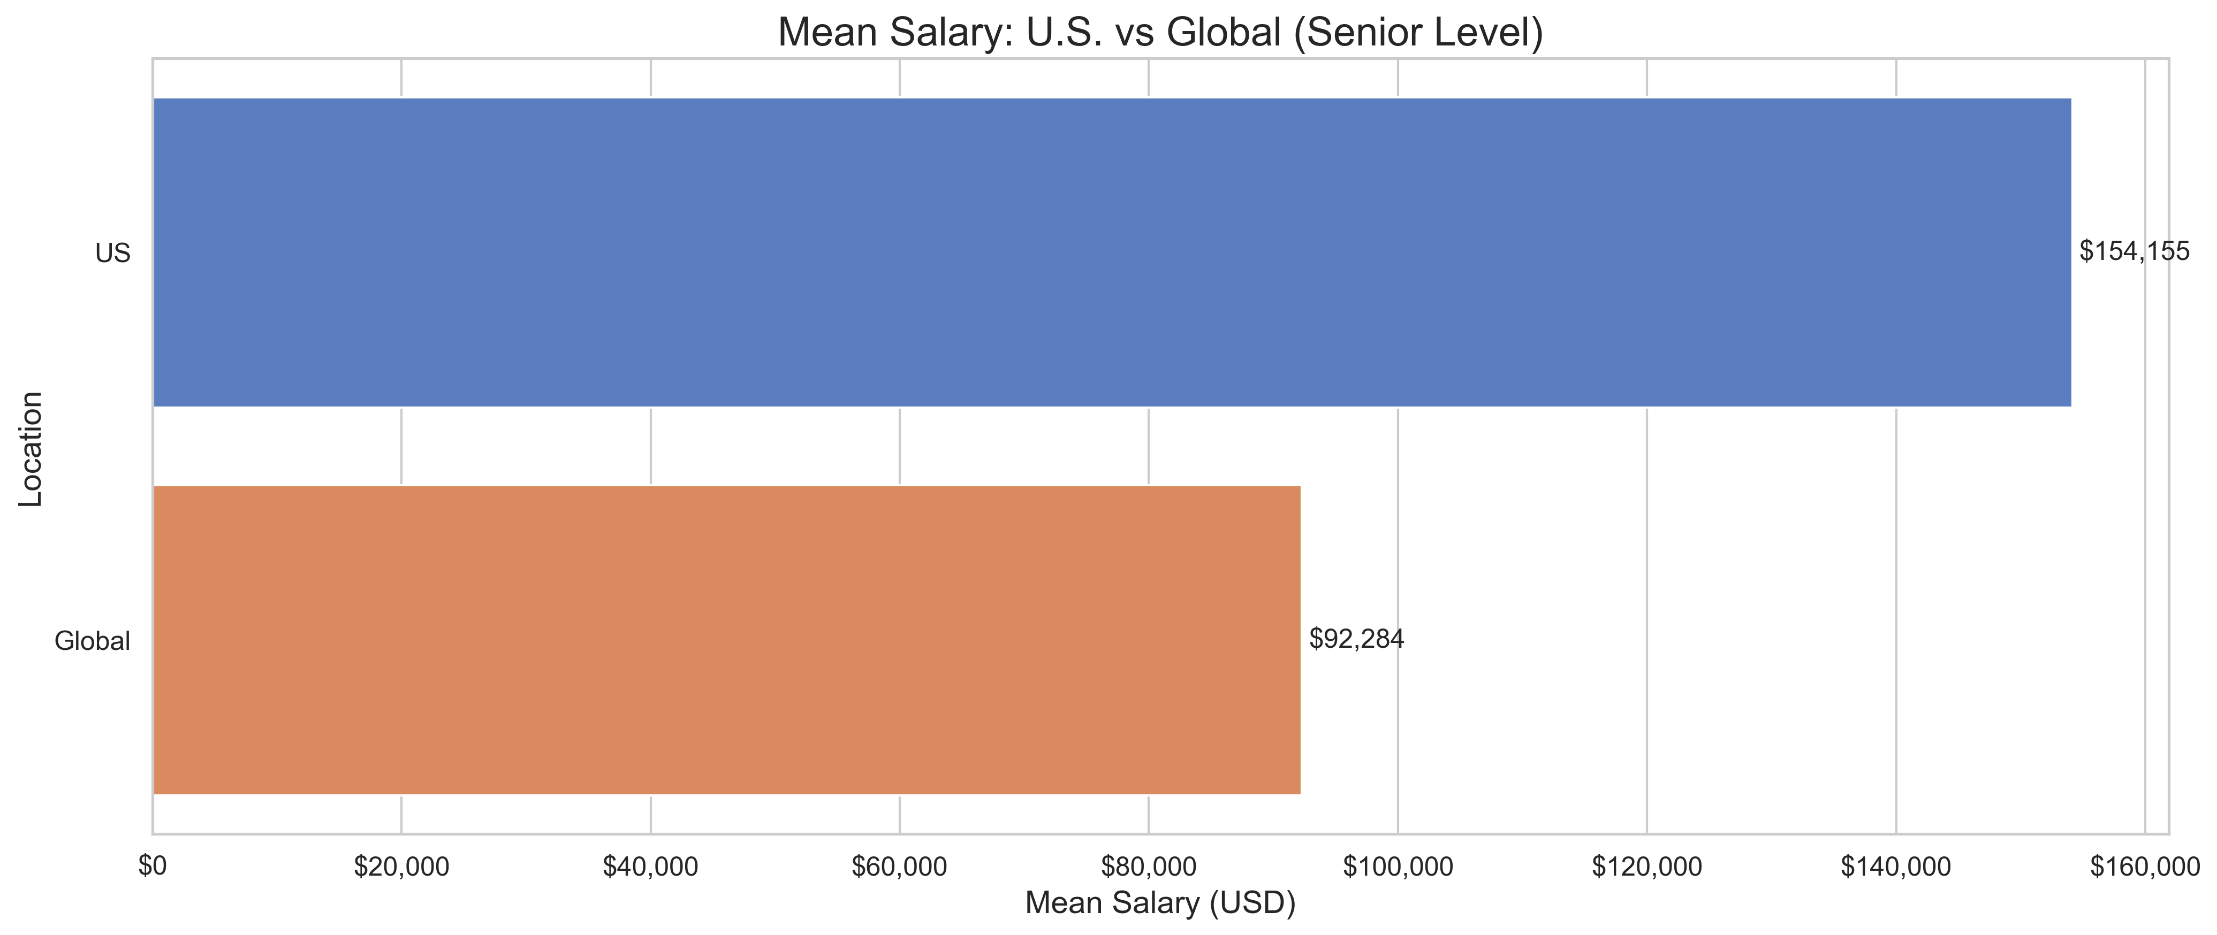
Key Salary Insights
Salary By Experience Level
U.S ($154,155) vs Global Salaries ($92,284)

Slide 3
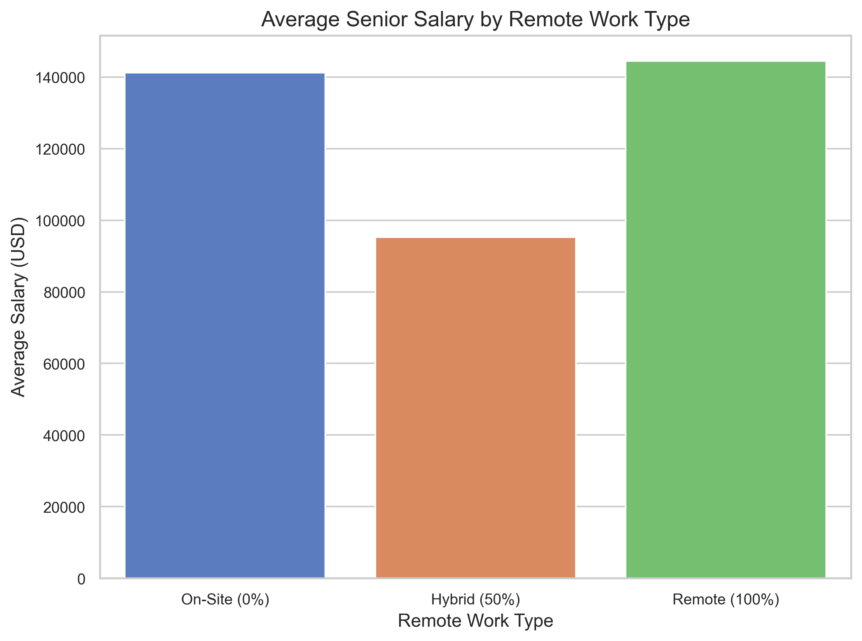
Final Recommendation
Recommended Salary Range: Offer between $100,000 and $170,000 USD for full-time Senior Data Scientists (based on IQR analysis).
U.S. Hire: Offer toward higher end to stay competitive (~31% premium vs global).
Remote/Hybrid Hire: Remote offers the ability to attract top talent globally while managing compensation costs.

